Slide 1
Anti sleep alarm
CIRCUIT DESIGN With Arduino
Milinda Madusan
Nimesha Yasith
Erandika Rathnayake
Danushi Mathrage

Slide 2

Problem
Fall asleep while learning/driving

Slide 3
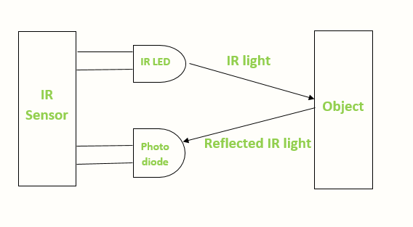
Design Concept
Use IR sensors to detect reflected radiations from the eye and use that signal to emit a sound if the user has fall asleep

Slide 4

Used Components
Arduino nano Board
9V Battery
IR Sensor
Goggles
Buzzer
Connecting wires
Toggle Switch

Slide 5
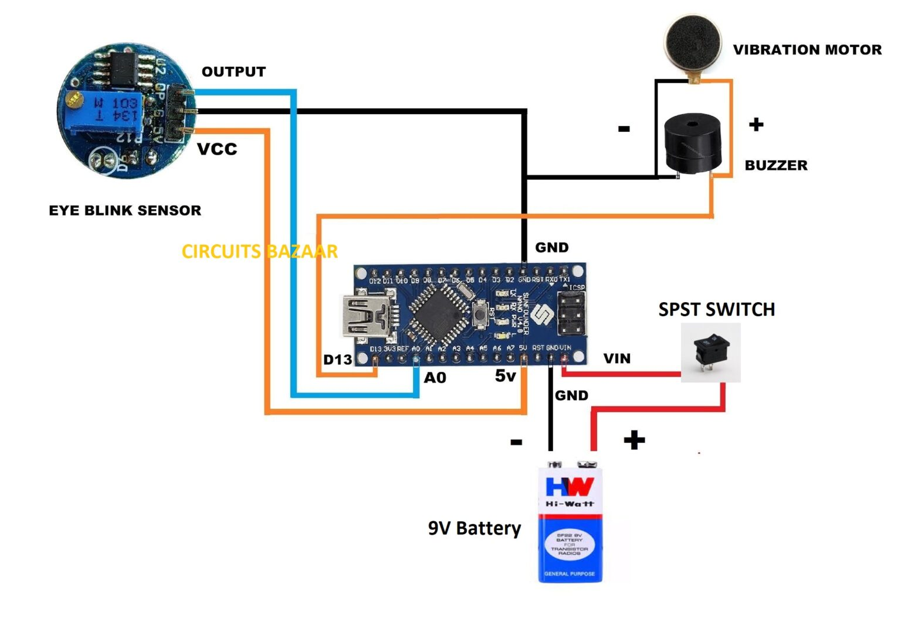
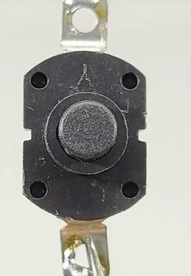














Circuit Diagram
IR

Slide 6
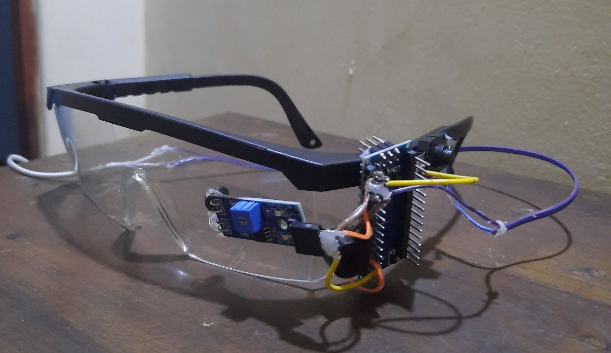
How The Design Solve The Given Problem?
If the driver fall asleep while driving, A noise indicating system starts to generate a noise and keep the driver awake

Slide 7
SMART GLASSES FOR BLIND PEOPLES
WITHOUT ARDUINO

Slide 8
Design concept
The importance of smart glasses for blind people lies in their potential to significantly improve the quality of life and independence of visually impaired individuals.
We can use hardware components to implement these circuits instead of using Arduino

Slide 9
Used Components
Ultrasonic Sensor
555 IC
100uF Capacitors
10uF Capacitor
1K Resistor
10K Potentiometer
Buzzer
3.7V Battery
Switch
Glasses
Some wire
Female header pin

Slide 10
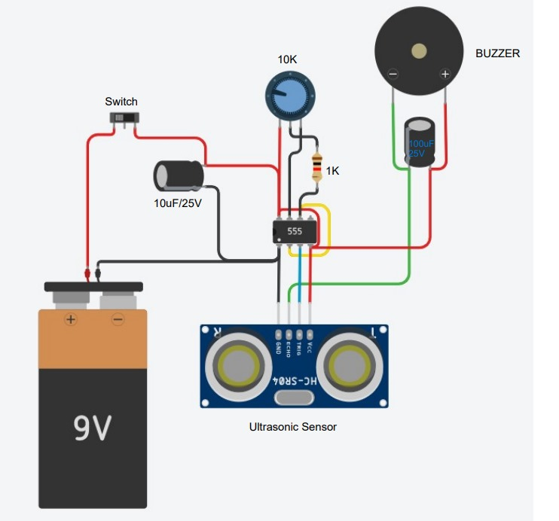
Circuit Diagram
3.7 V

Slide 11
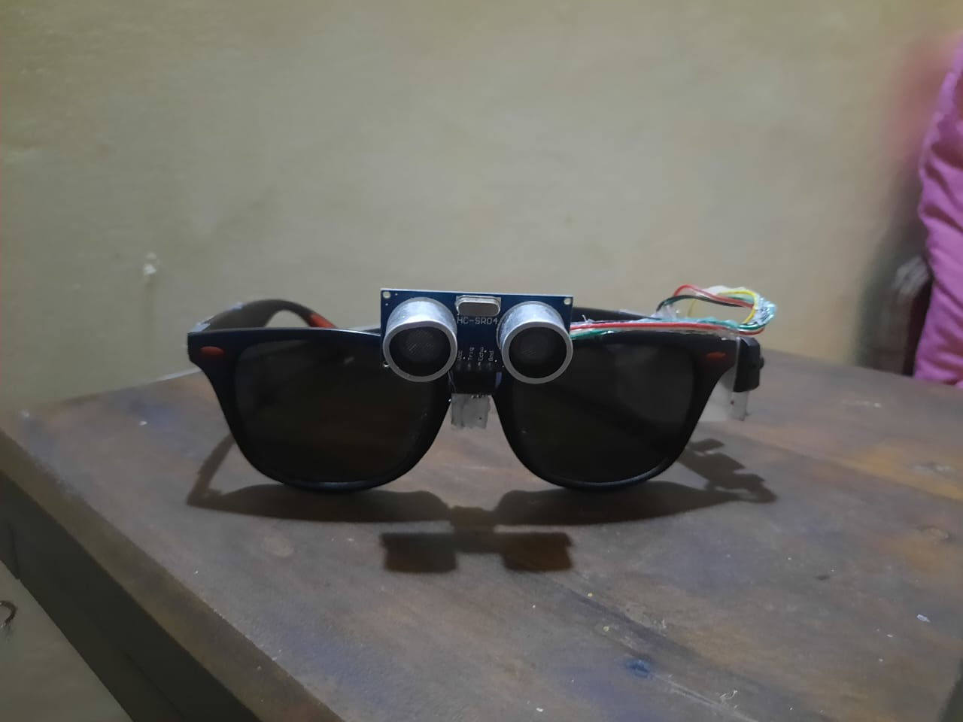
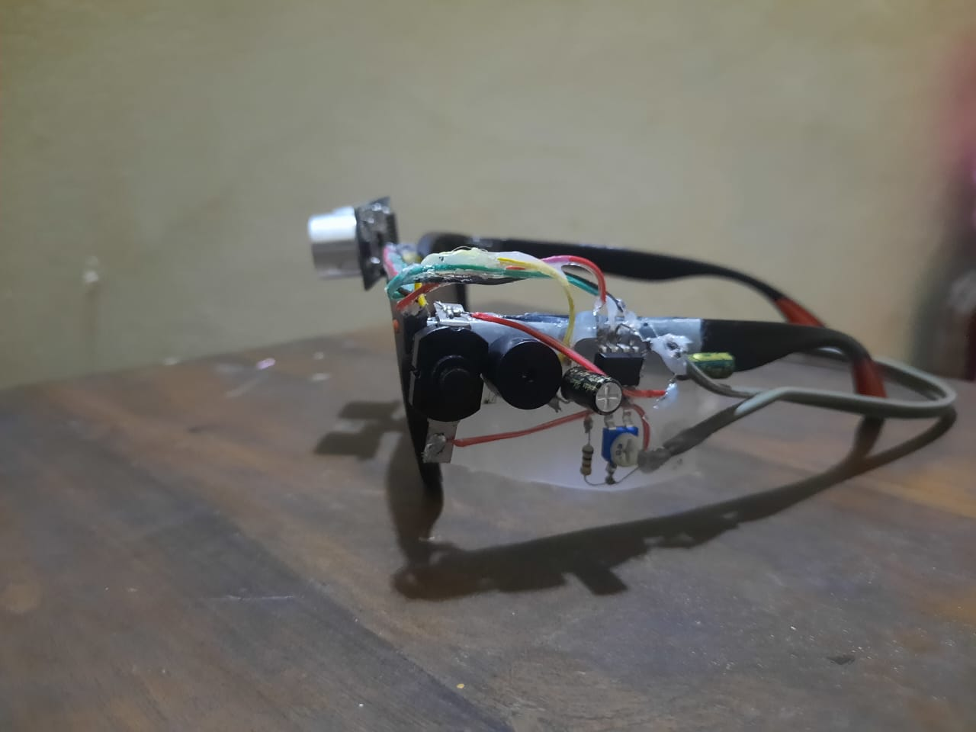
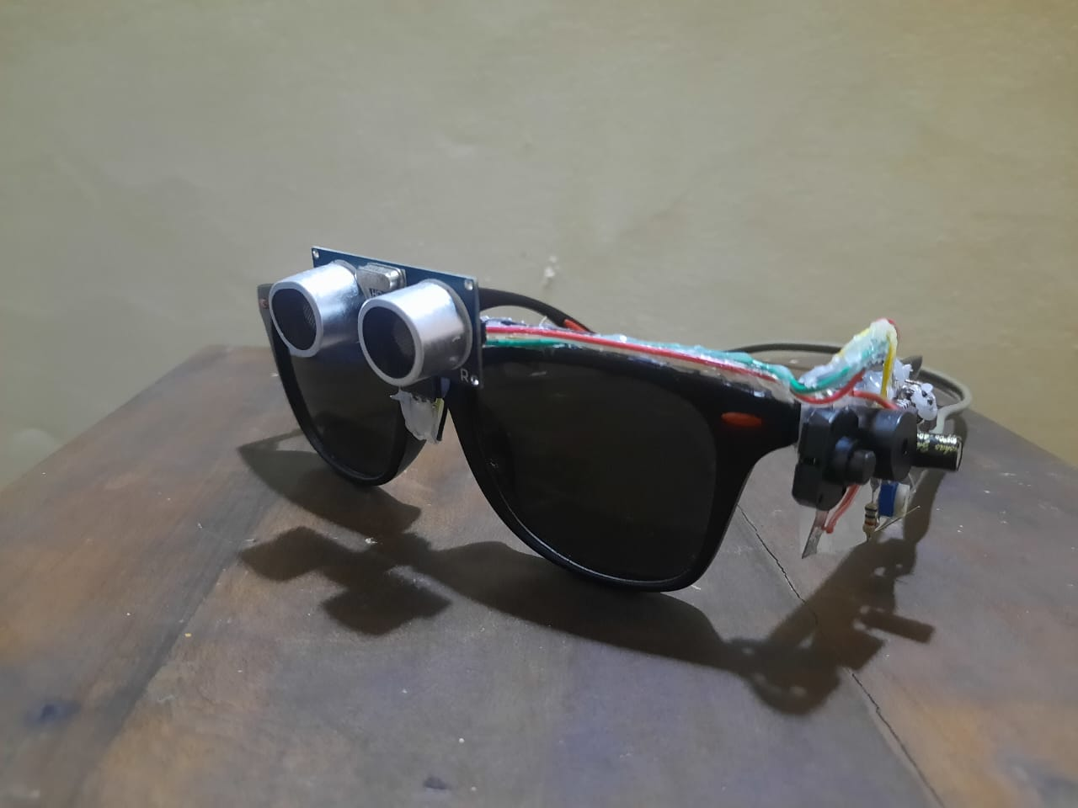
Design
Circuit helps the blind individuals navigate their surroundings safely by alerting them to obstacles in their path.

Slide 12
How it work?
When any object comes in front of the ultrasonic sensor, the ultrasonic wave from the sensor will reflect on the object and return to the receiver.
The sensor calculates the distance to the obstacle based on the time taken for the ultrasonic waves to return to the receiver.
If an obstacle is detected within a predefined range, the echo pin of the ultrasonic sensor sends a signal to the buzzer.
Then the buzzer starts buzzing sound to alert the blind person about the obstacle.
Therefore circuit helps the blind individuals navigate their surroundings safely by alerting them to obstacles in their path.

Slide 13


